Slide 1

Deep Learning
DSBA 6190-U90 | Colby T. Ford, Ph.D.

Slide 2
Overview
Other Cluster Technologies
Intro to Deep Learning
Deep Learning Frameworks
Overview of Neural Networks
Processors

Slide 3
Goals:
Understand what neural networks are.
Understand why you need to use GPUs to train them.
Understand why the cloud might be a good place to do so.

Slide 4
Other Cluster Technologies
Parallel Virtual Machine (PVM)
Only for low-level languages like FORTRAN, C, and C++
Oak Ridge National Laboratory, 1989
Message Passing Interface (MPI)
Only for low-level languages, but plenty of interfaces to higher-level languages like R, Python, Java, etc.
Most popular today.
Dongarra, et al., 1992
Scalable Network of Workstations (SNOW)
Only for R
Tierney, et al., 2009
Common themes:
Multiple machines connected together (ethernet, infiniband, etc.)
Parallelism is based on cores across the cluster
Sharing resources like memory, HDD, CPUs, GPUs, etc.

Slide 5

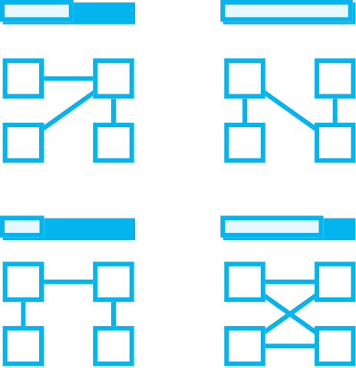


Intro to Machine Learning
Deep
Prepare Data
Build & Train
Deploy
Connect to various sources to ingest data
Train with the data to establish a model
Deploy the model and track performance

Slide 6
Deep Learning Frameworks
TensorFlow
CNTK
MXNet
Microsoft
Google
Apache
PyTorch
Chainer
Facebook
Caffe2
Berkeley
Keras
François Chollet
Preferred Networks
Theano
University of Montreal

Slide 7

Deep Learning Options in the Cloud
Databricks
Machine Learning
DLVM

Slide 8
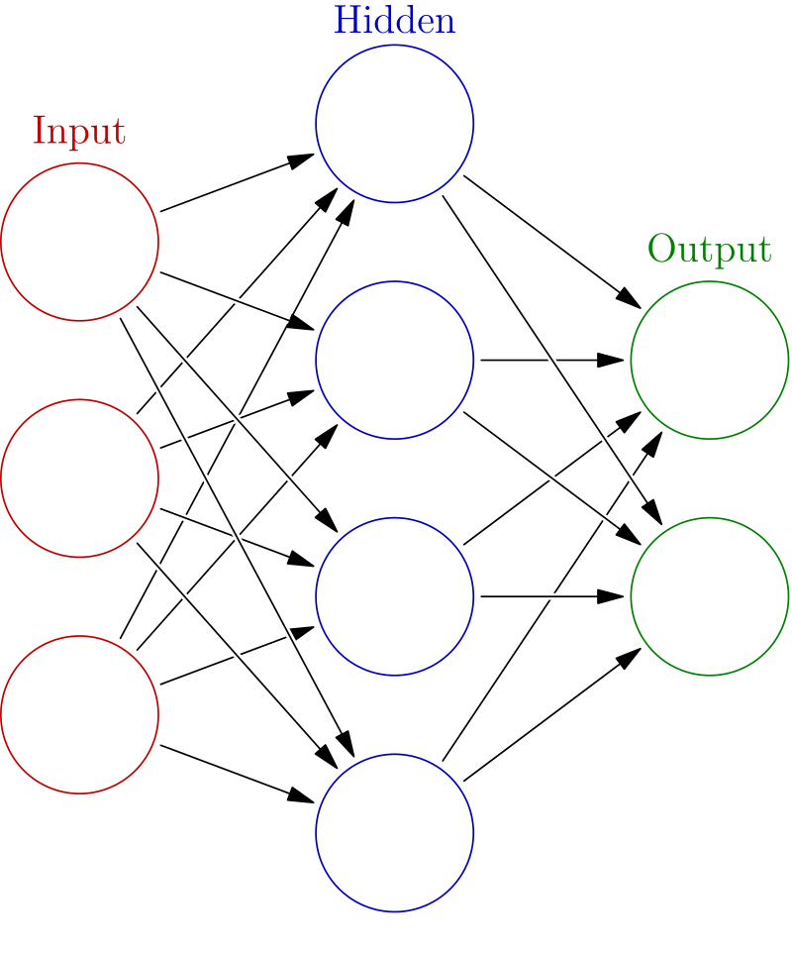
Overview of Neural Networks
Built using interconnected nodes in multiple layers
Layers:
Input:
The set of input features
Hidden:
Set of mathematical functions to compute activations
Output:
The predicted class or value
Connections:
Directional weights
Examples:
Recurrent Neural Networks
Useful for NLP
Convolutional Neural Networks
Useful in Image Recognition
Long Short-Term Memory
Useful for Time Series
…tons more
“Deep” just means there are multiple layers…
https://commons.wikimedia.org/w/index.php?title=File:Colored_neural_network.svg&oldid=279111871
16:07

Slide 9

http://www.asimovinstitute.org/neural-network-zoo/

Slide 10

ONNX
Open Neural Network Exchange
An open-source, standardized format for describing neural network models [*.onnx]
Helps in usability when the model object is framework-agnostic
Model Zoo: a place to publish your trained model for open, external use

Slide 11
Types of Processors (Well, the ones relevant to ML/DL/AI)
Central Processing Unit
1-32 Cores
up to ~5GHz
Single precision (32-bit), Double precision (64-bit) and possibly Extended precision (128-bit)
Graphics Processing Unit
100s-1000s of slower cores
~500-1200MHz
Field Programmable Gate Array
Reconfigurable chips to do a specific task – using programmable logic blocks
Tensor Processing Unit
Developed by Google (especially for use in TensorFlow).
High volume, low precision (8-bit)
Proprietary, but can be used on GCP
Useful in IoT/Edge scenarios
Single precision to Double precision

Slide 12
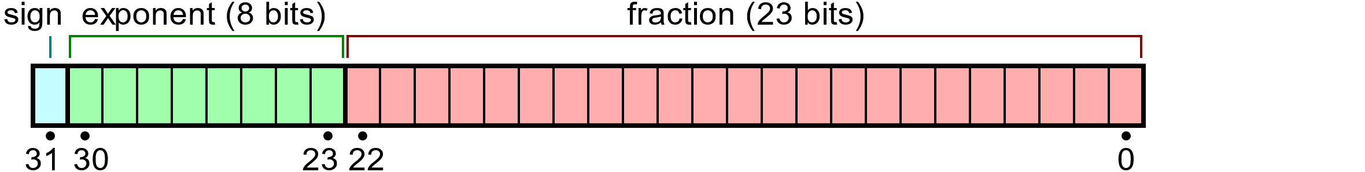
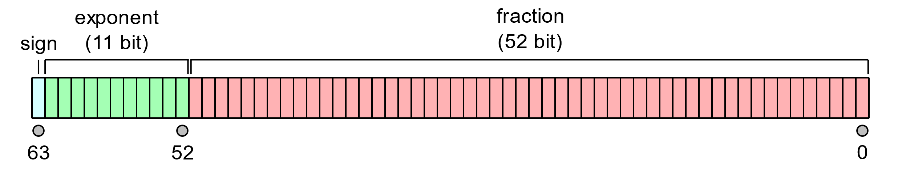
Precision, Precisely
Single Precision
Max Signed Integer Value: 2³¹ − 1 = 2,147,483,647
Max IEEE 754 Value: (2 − 2⁻²³) × 2¹²⁷ ≈ 3.4028235 × 10³⁸
Significant Digits: up to 9
Double Precision
Max Signed Integer Value: 2⁶³ − 1 = 9,223,372,036,854,775,807
Max IEEE 754 Value: (2 − 2⁻⁵²) × 2¹⁰²³ ≈ 1.7976931 × 10³⁰⁸
Significant Digits: up to 17
Binary32 Example
Input: 3.14159265358
Stored as: 3.1415927410125732421875
Error: 8.74325732421875E-8
Binary: 0 10000000 10010010000111111011011
Binary64 Example
Input: 3.14159265358
Stored as: 3.1415926535800000607423498877324163913726806640625
Error: 6.07423498877324163913726806640625E-17
Binary: 0 10000000000 1001001000011111101101010100010000111101011011110100
Notes:
Fun fact: The “fraction” part of the IEEE Value is called the “Mantissa”

Slide 13


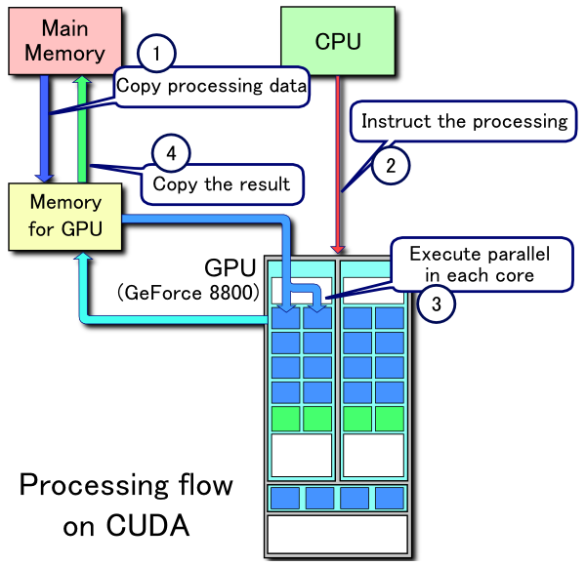
CUDA and OpenCL
CUDA
Developed by Nvidia
For use on Nvidia or CUDA-enable GPUs
Parallelized functionality for linear algebra, sparse matrices, Fourier transforms, random numbers, solvers, graph processing, and more.
OpenCL
Originally developed by Apple, maintained by the Khronos Group
For use in CPUs, GPUs, and FPGAs (for a variety of vendors)
Parallelized functionality for matrix algebra, vectors (especially images)
CUDA Processing Flow by Tosaka [CC BY 3.0 (https://creativecommons.org/licenses/by/3.0)]

Slide 14
Keras Model Walkthrough
IMDB Dataset
Models and Compiling
Layers
Fit, Save, and Show

Slide 15
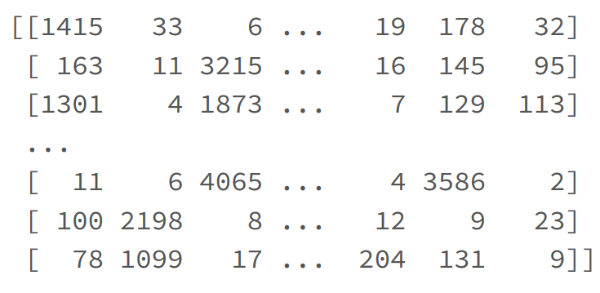
IMDB Dataset
Dataset of 25,000 movies reviews from IMDB, labeled by sentiment (positive/negative). Reviews have been preprocessed, and each review is encoded as a sequence of word indexes (integers).
For convenience, words are indexed by overall frequency in the dataset, so that for instance the integer "3" encodes the 3rd most frequent word in the data. This allows for quick filtering operations such as: "only consider the top 10,000 most common words, but eliminate the top 20 most common words".

Slide 16
Models and Compiling
Sequential – a linear stack of layers. Specify input shape and then add layers
model = Sequential()
model.add(Dense(32, input_shape=(16,)))
model.add(Conv2D(64, (3,3), activation…)
Compiling – set up the performance settings of the model.
Optimizer:
Stochastic gradient descent, RMSprop
Adagrad, Adadelta, Adamax
Adam, Nadam
Loss Function:
Mean squared error, mean absolute error, mean absolute percentage error, mean squared logarithmic error
Hinge, squared hinge
Kullback-Leibler divergence
Logcosh, cosine proximity
Cross entropy
Other Metrics:
Accuracy
model.compile()

Slide 17
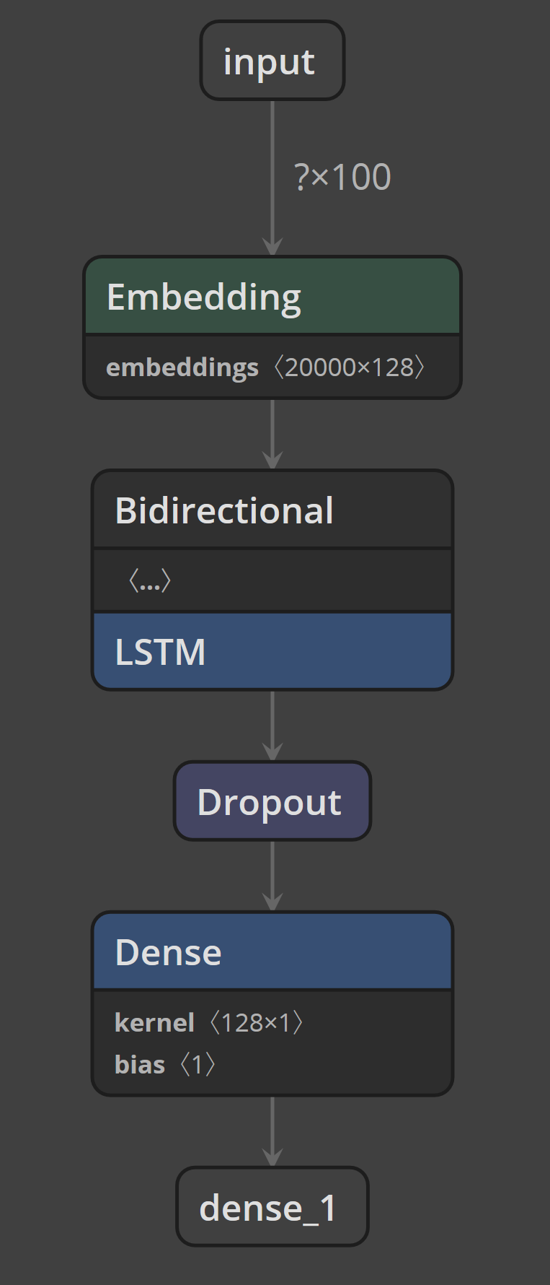
Layers
model.add(Embedding(max_features, 128, input_length=maxlen))
Turns positive integers (indexes) into dense vectors of fixed size.
model.add(Bidirectional(LSTM(64)))
Bidirectional means that the process can move forward and backward.
LSTM creates a ‘long short-term memory’ RNN of a specified size.
model.add(Dropout(0.5))
Dropout consists in randomly setting a fraction (rate) of input units to 0 at each update during training time, which helps prevent overfitting.
model.add(Dense(1, activation='sigmoid'))
The dense layer is fully connected layer, so all the neurons in a layer are connected to those in a next layer.
http://colah.github.io/posts/2015-08-Understanding-LSTMs/

Slide 18
Fit, Save, and Show
CNN Example
Netron
model.fit(x_train, y_train,
batch_size=batch_size,
epochs=4,
validation_data=[x_test, y_test])
Batch size: number of samples per gradient update
Epochs: Number of iterations over the entire x & y data
from keras.models import load_model
# save to the local filesystem
model.save('/tmp/imdb_lstm_model.h5’)
# move to a for future use
dbfs_model_path = 'dbfs:/mnt/general/trainedmodels/dl/imdb_lstm_model.h5’
dbutils.fs.cp('file:/tmp/imdb_lstm_model.h5', dbfs_model_path)

Slide 19
Containerization and Model Operationalization
Containerization
Kubernetes and Docker
AKS and ACI
Function Apps
Operationalization
Batch
ADFv2
Realtime Scoring
APIs

Slide 20
Operationalization

Slide 21
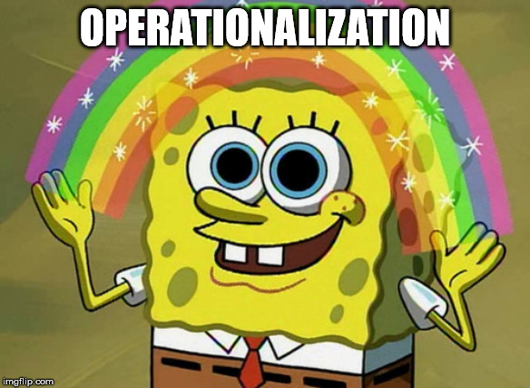
“Now that my client has an ML model that they’re happy with, how do we go about using it in production?”

Slide 22



Options in Azure
Batch Scoring in Databricks
Deployment with Azure Machine Learning
Custom Deployment with Function Apps (or other services)

Slide 23


Batch Scoring in Databricks
Option 1:
Use ADFv2 as the Orchestrator
Option 2:
Use Databricks Jobs

Slide 24
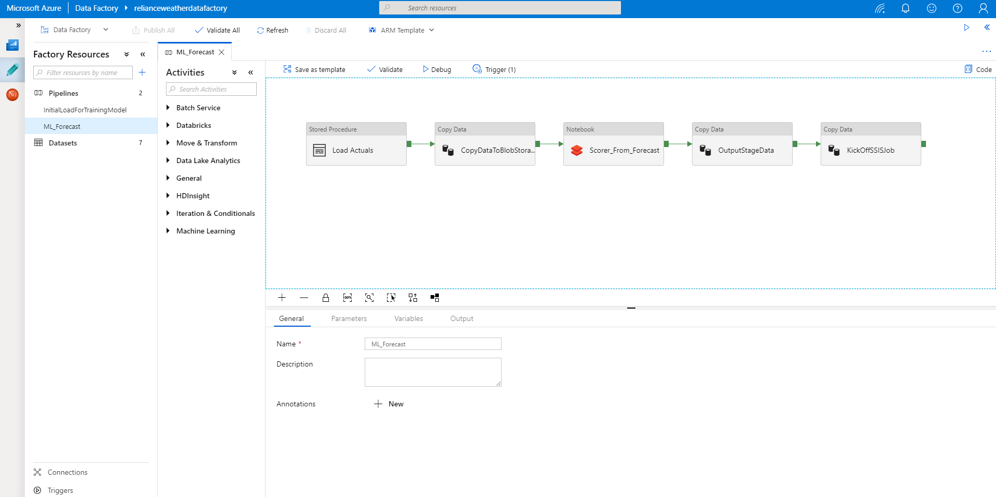
Databricks + Azure Data Factory

Slide 25
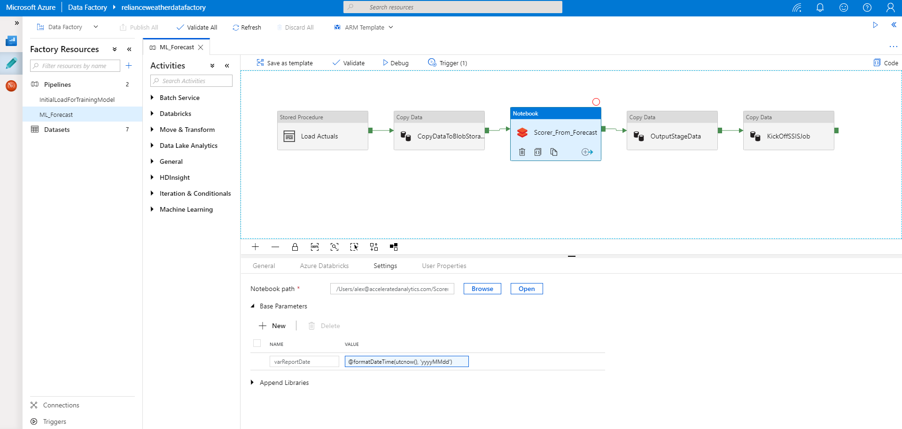
Databricks + Azure Data Factory

Slide 26



API Serving using MMLSpark
Linux VM
External Application
API
Peering
(Could by an App, Python process, etc.)
VM VNET
Workers VNET

Slide 27
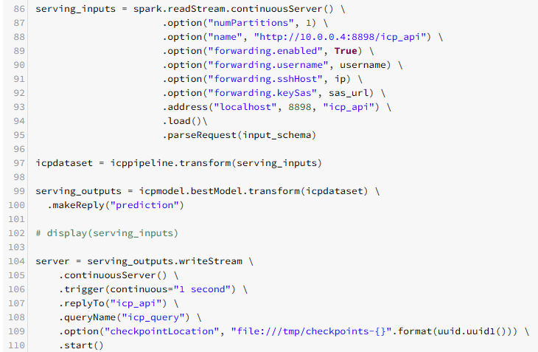
API Serving Example
From the CHOA ICP PoC

Slide 28
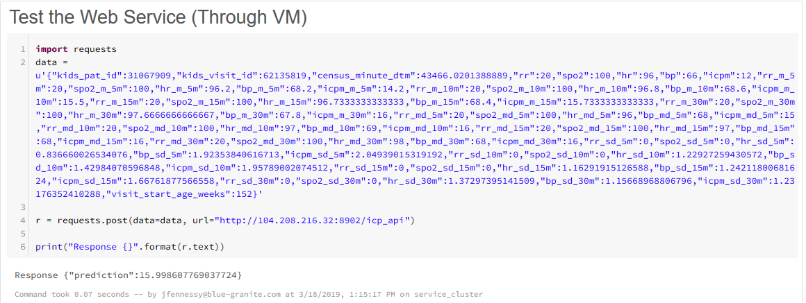
API Serving Example
From the CHOA ICP PoC

Slide 29
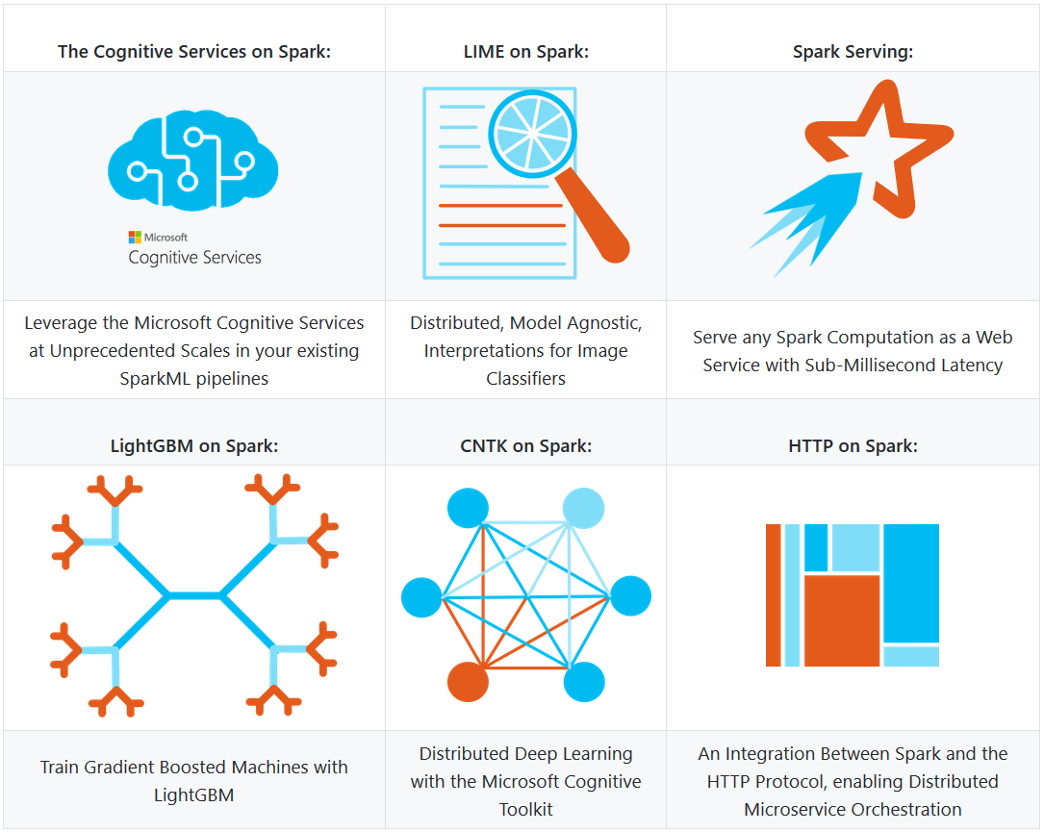
Other Features of MMLSpark
https://github.com/Azure/mmlspark

Slide 30
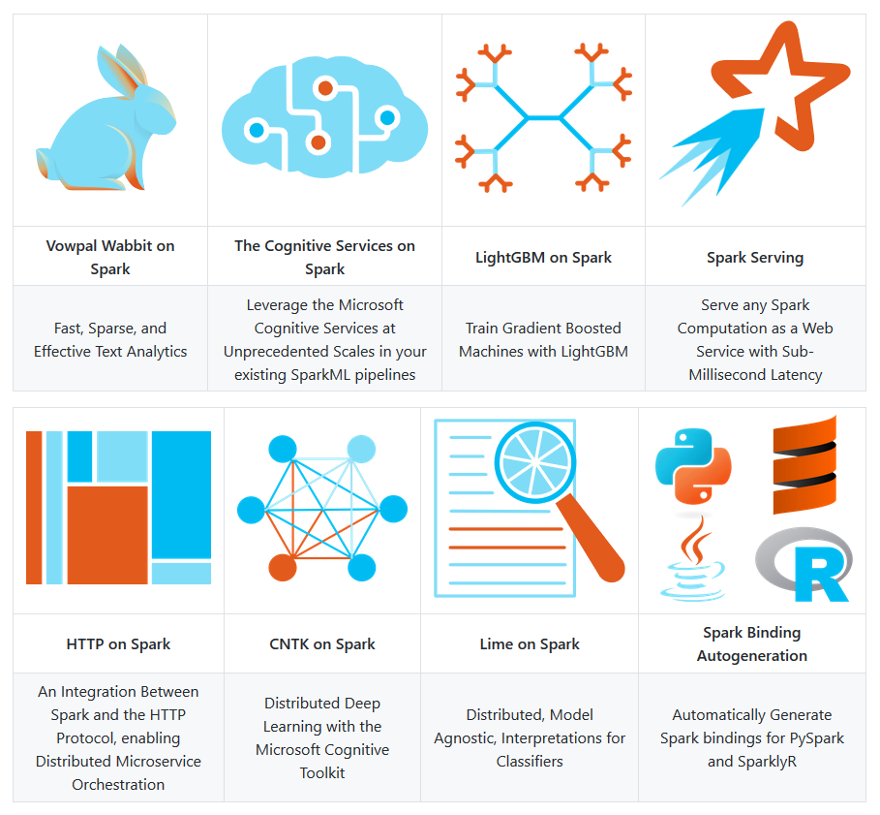
Other Features of MMLSpark
https://github.com/Azure/mmlspark

Slide 31
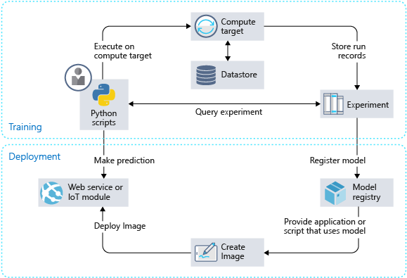
Deployment on Azure Machine Learning Service
The workflow generally follows this sequence:
Develop machine learning training scripts in Python.
Create and configure a compute target.
Submit the scripts to the configured compute target to run in that environment.
Query the experiment for logged metrics from the current and past runs.
After a satisfactory run is found, register the persisted model in the model registry.
Develop a scoring script.
Create an image and register it in the image registry.
Deploy the image as a web service in Azure.
https://docs.microsoft.com/en-us/azure/machine-learning/service/how-to-deploy-and-where

Slide 32
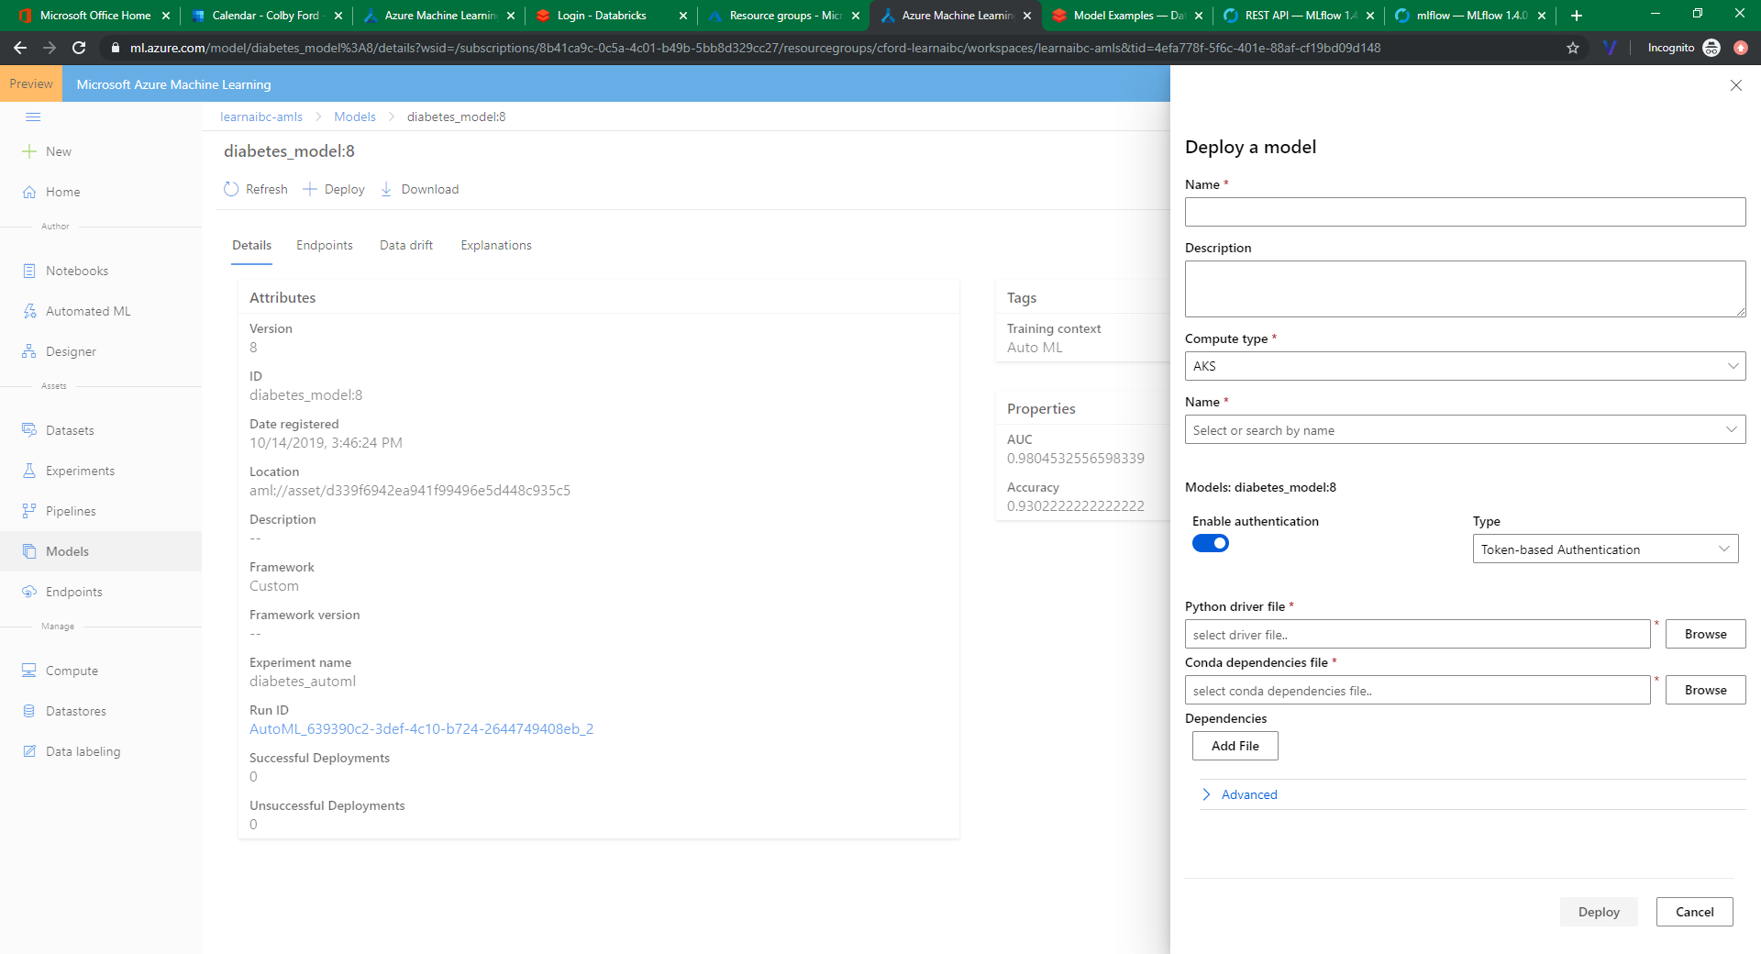
Containerized Deployment in AMLS

Slide 33
Where Can We Deploy This Stuff (in Azure)?
Model was Created Using… | I Can Deploy…
Databricks or normal Spark (MLlib, H₂O Sparkling Water, etc.) | As a Batch Service: As a Databricks Job Using ADFv2 to Call Scoring Jobs As a Realtime Webservice: MMLSpark In Synpase? Score as part of a query using a Spark Pool
Some other Python Package (sklearn, Keras, Pytorch, etc.) | AMLS as a Realtime Webservice: AKS/ACI Azure IoT Edge FPGAs AMLS as a Batch Service: AML Compute Function as an API
Some other R Package | ☹ (Maybe using custom deployment with Functions) *R SDK for AMLS Once Updated?

Slide 34
…
Hint: The importance value set between nodes of different layers
Hint: The math function that makes a neuron “light up”

Slide 35
Deploying Azure Resources
Infrastructure as Code
ARMs and Biceps
Terraform
GitHub Actions / DevOps Build Pipelines

Slide 36
Deployment is Easy Necessary
“Infrastructure as Code” – The ability to deploy all your services in the cloud from code rather than manually.
Important for:
IT management of resources
Geo-replication / Global availability and scale
Security

Slide 37



Infrastructure as Code Options
ARM Templates
Bicep Language
Terraform
Pro: Azure can generate them.
Con: Difficult to read and edit.
Pro: From Microsoft. Easy to read.
Con: Lacking in examples and docs.
Pro: From HashiCorp. Multicloud.
Con: Proprietary and Pricey
Templates overview - Azure Resource Manager | Microsoft Docs
Bicep language for deploying Azure resources - Azure Resource Manager | Microsoft Docs
Docs overview | hashicorp/azurerm | Terraform Registry

Slide 38
IaC Language Learning Curve
{
"$schema": "https://schema.management.azure.com/schemas/2019-04-01/deploymentTemplate.json#",
"contentVersion": "1.0.0.0",
"parameters": {
"location": {
"type": "string",
"defaultValue": "[resourceGroup().location]"
},
"storageAccountName": {
"type": "string",
"defaultValue": "[format(myStorage{0}', uniqueString(resourceGroup().id))]"
}
},
"resources": [
{
"type": "Microsoft.Storage/storageAccounts",
"apiVersion": "2021-06-01",
"name": "[parameters('storageAccountName')]",
"location": "[parameters('location')]",
"sku": {
"name": "Standard_LRS"
},
"kind": "StorageV2",
"properties": {
"accessTier": "Hot"
}
}
]
}
param location string = resourceGroup().location
param storageAccountName string = myStorage${uniqueString(resourceGroup().id)}'
resource storageAccount 'Microsoft.Storage/storageAccounts@2021-06-01' = {
name: storageAccountName
location: location
sku: {
name: 'Standard_LRS'
}
kind: 'StorageV2'
properties: {
accessTier: 'Hot'
}
}
BICEP
resource "azurerm_storage_account" "mystorage" {
name = "myStorage${random_integer.id.result}"
resource_group_name = azurerm_resource_group.rg.name
location = azurerm_resource_group.rg.location
account_tier = "Standard"
account_replication_type = "LRS"
tags = { environment = ”dev" }
}
TF (HCL)
ARM (JSON)

Slide 39
Deploying with GitHub Actions

Slide 40
Security, Compliance, and Data Governance
Role-Based Access Controls
Azure Active Directory
Access Control Lists in Azure Storage
Compliance
HIPAA, HITRUST, SOX, ISO
Blueprints, etc.
Data Governance
Azure Purview

Slide 41
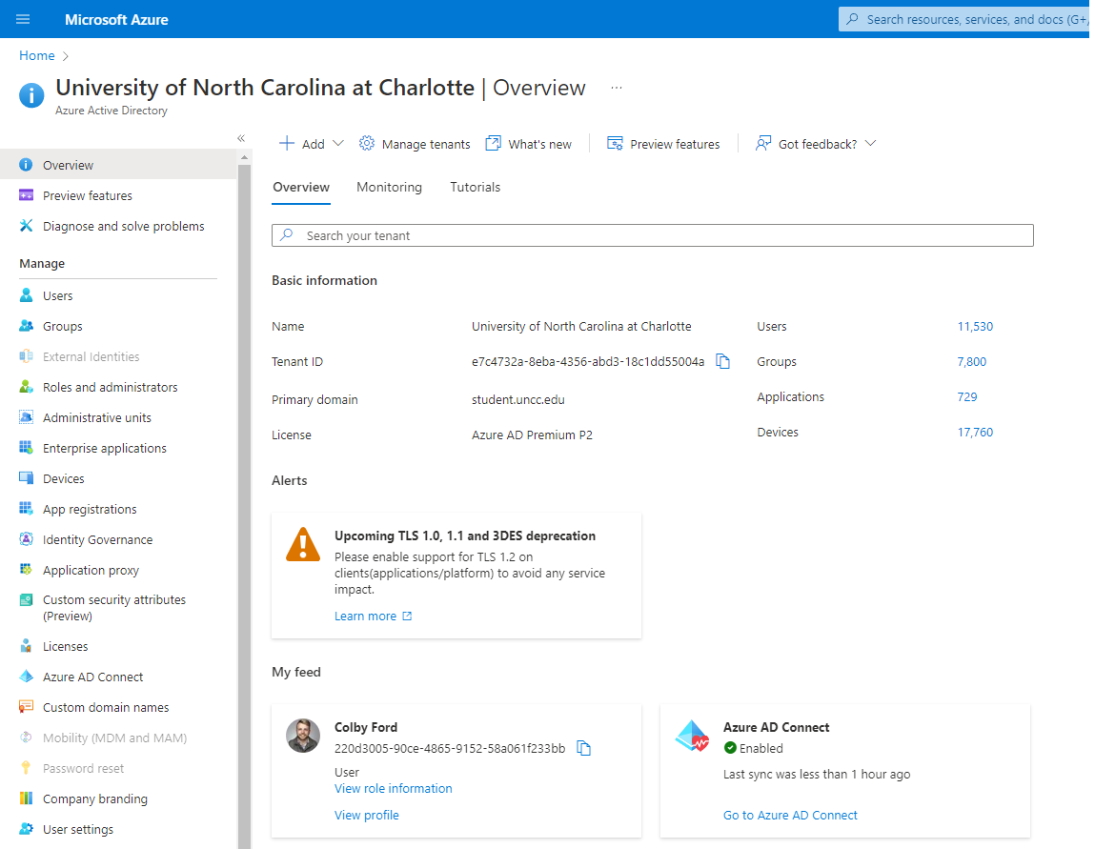

Azure Active Directory
Identity management for users and applications.
Single Sign-On (SSO)
App registrations
External applications
Service Principals and Managed Identities
Role assignments
Group organization

Slide 42
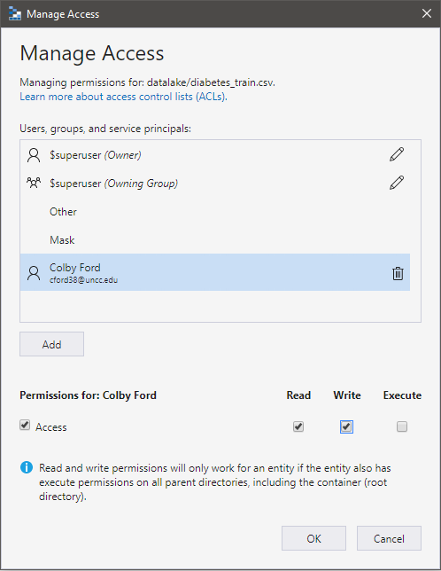

RBAC and Access Control Lists
Common Role-Based Access Controls:
Owner
Grants full access to manage all resources, including the ability to assign roles in Azure RBAC.
Contributor
Grants full access to manage all resources, but does not allow you to assign roles in Azure RBAC
Reader
View all resources but does not allow you to make any changes.
RBAC: Broad Access to Resources
ACLs: Finer Access to Data

Slide 43
Compliance noun - com·​pli·​ance | \ kəm-ˈplī-ən(t)s \ “Conformity in fulfilling official requirements”

Slide 44
Global CIS benchmark CSA STAR Attestation CSA STAR Certification CSA STAR self-assessment SOC 1 SOC 2 SOC 3 ISO 20000-1 ISO 22301 ISO 27001 ISO 27017 ISO 27018 ISO 27701 ISO 9001 WCAG | US government CJIS CMMC CNSSI 1253 DFARS DoD IL2 DoD IL4 DoD IL5 DoD IL6 DoE 10 CFR Part 810 EAR FedRAMP FIPS 140 ICD 503 IRS 1075 ITAR JSIG NDAA NIST 800-161 NIST 800-171 NIST 800-53 NIST 800-63 NIST CSF Section 508 VPATs StateRAMP | Financial services 23 NYCRR Part 500 (US) AFM and DNB (Netherlands) AMF and ACPR (France) APRA (Australia) CFTC 1.31 (US) EBA (EU) FCA and PRA (UK) FFIEC (US) FINMA (Switzerland) FINRA 4511 (US) FISC (Japan) FSA (Denmark) GLBA (US) KNF (Poland) MAS and ABS (Singapore) NBB and FSMA (Belgium) OSFI (Canada) OSPAR (Singapore) PCI 3DS PCI DSS RBI and IRDAI (India) SEC 17a-4 (US) SEC Regulation SCI (US) SOX (US) TruSight | Automotive, education, energy, media, and telecommunication CDSA DPP (UK) FACT (UK) FERPA (US) MPA GSMA NERC (US) TISAX
 |  |  | Regional - Americas Argentina PDPA Canada privacy laws Canada Protected B US CCPA | Regional - EMEA EU Cloud CoC EU EN 301 549 ENISA IAF EU GDPR EU Model Clauses Germany C5 Germany IT-Grundschutz workbook Netherlands BIR 2012 Russia personal data law Spain ENS High Spain LOPD UAE DESC UK Cyber Essentials Plus UK G-Cloud UK PASF
Healthcare and life sciences ASIP HDS (France) EPCS (US) GxP (FDA 21 CFR Part 11) HIPAA (US) HITRUST MARS-E (US) NEN 7510 (Netherlands) |  |  | Regional - Asia Pacific Australia IRAP China GB 18030 China DJCP (MLPS) China TCS India MeitY Japan CS Gold Mark Japan ISMAP Japan My Number Act Korea K-ISMS New Zealand ISPC Singapore MTCS | Regional - EMEA EU Cloud CoC EU EN 301 549 ENISA IAF EU GDPR EU Model Clauses Germany C5 Germany IT-Grundschutz workbook Netherlands BIR 2012 Russia personal data law Spain ENS High Spain LOPD UAE DESC UK Cyber Essentials Plus UK G-Cloud UK PASF
Azure Compliance Offerings

Slide 45

HIPAA, HITECT, and HITRUST
Name
Telephone Number
Address
Dates (Smaller than years)
Fax Number
Email Address
Social Security Number
Medical Record Number
Health Plan Beneficiary Number
Account Numbers
License Number
Vehicle Identifiers
Device Identifiers and Serial Numbers
Web URLs
IP Addresses
Biometric Identifiers
Fingerprints, voice recording, etc.
Face Photos
Any other unique ID
HIPAA: Health Insurance Portability and Accountability Act of 1996
Sets requirements for using, disclosing, and handling protected health information (PHI)
HITECH: Health Information Technology for Economic and Clinical Health Act of 2009
Extends HIPAA for electronic health records and more modern, data-driven technology in healthcare
HITRUST: Health Information Trust Alliance
A private company that sets standards, based on HIPAA/HITECH, and provides certification.
https://docs.microsoft.com/en-us/azure/compliance/offerings/offering-hipaa-us

Slide 46
SOX
Retain data for the req’d amount of time
Manage security and access controls
Know when something is deleted or changed (version control)
Physical and electronic access
Offsite backups
Prevent data tampering
Audit trails, logs
Prove you’ve retained compliance for a rolling 90 days
Visibility into system and org compliance
Sarbanes-Oxley Act of 2002
US federal law from the Securities and Exchange Commission (SEC)
Mandates financial record keeping practices
Thanks to the ENRON and WorldCom scandals

Slide 47
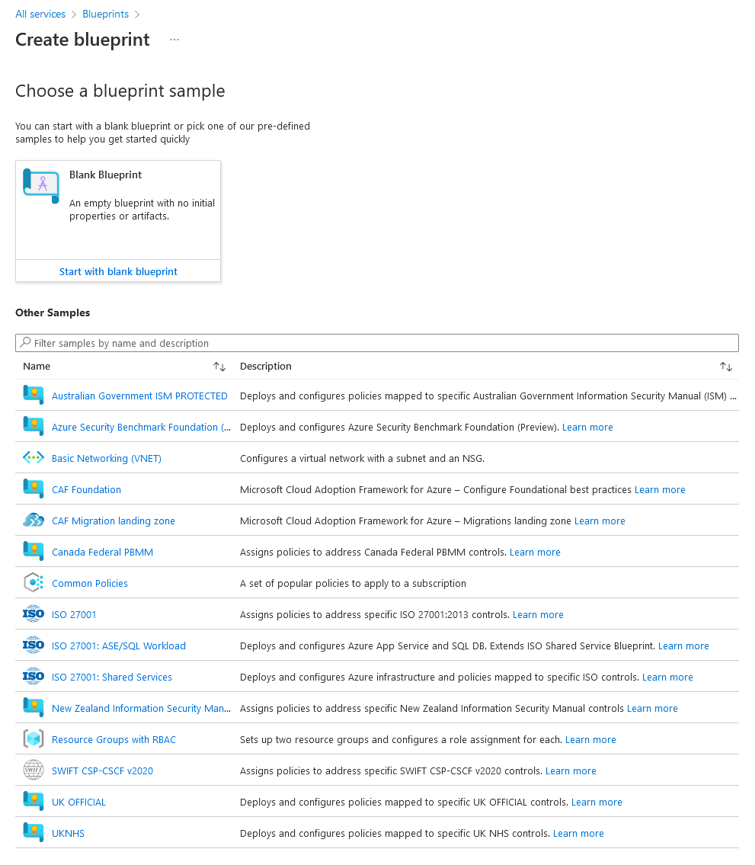

Azure Blueprints
Set of organizational standards and requirements for compliances or policy adherence.
Orchestrate the deployment of artifacts:
Role Assignments
Policy Assignments
Azure Resource Manager templates (ARM templates)
Resource Groups

Slide 48
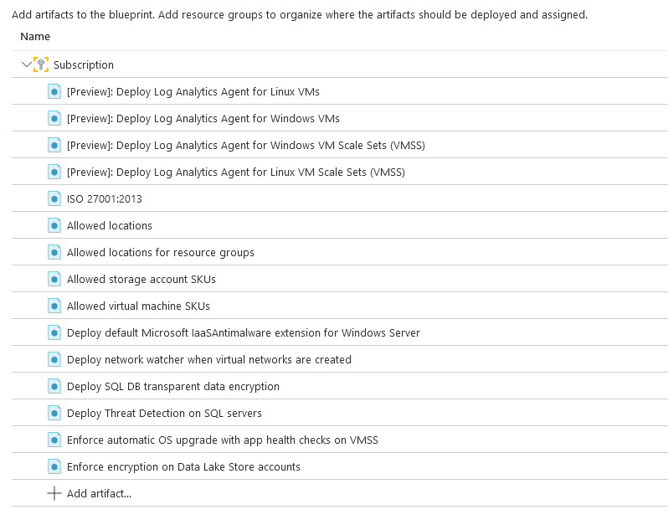

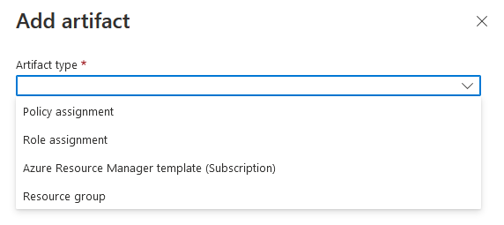
ISO 27001
International Standard for information security
14 main Controls
Information security policies, HR security, asset management, access control, cryptography, physical security, etc.

Slide 49
Now that I have a bunch of stuff in the cloud, how do I see it all?

Slide 50
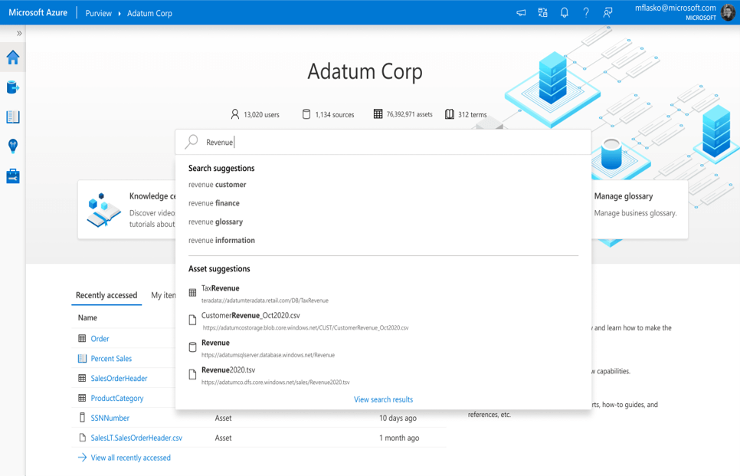
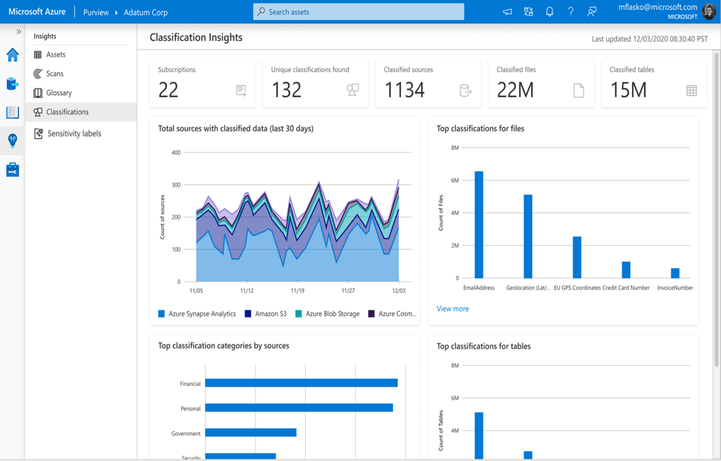
Azure Purview
Data governance platform in Azure that allows us to manage on-prem and multicloud data and services.
Create a map of your data estate – “Data Catalog”
Find, label, and track sensitive data.
See how data flows through your platforms

Slide 51
